Slide 1
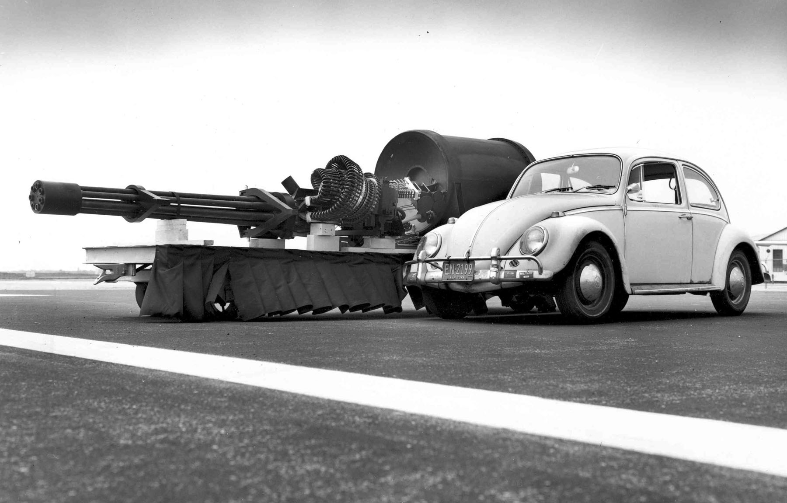

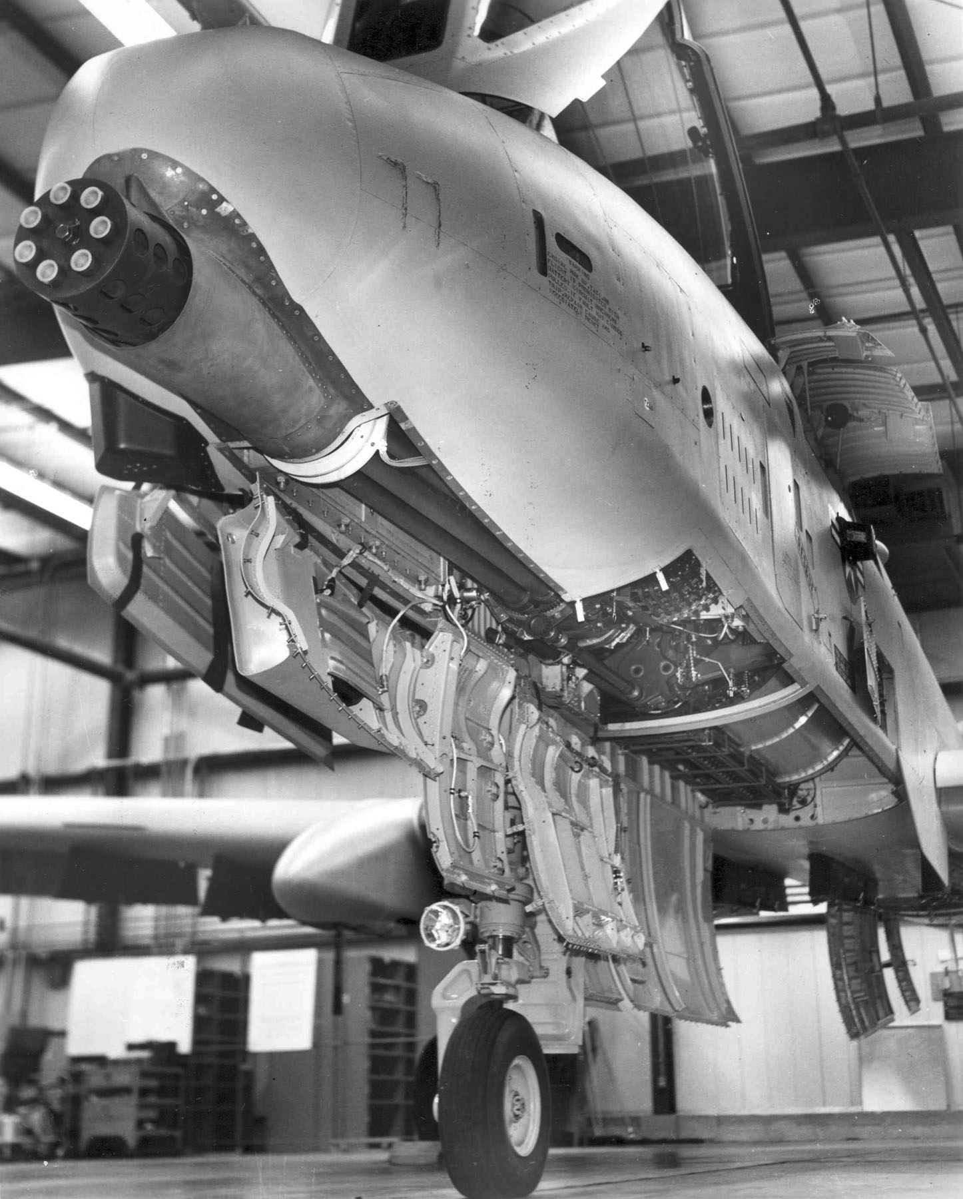
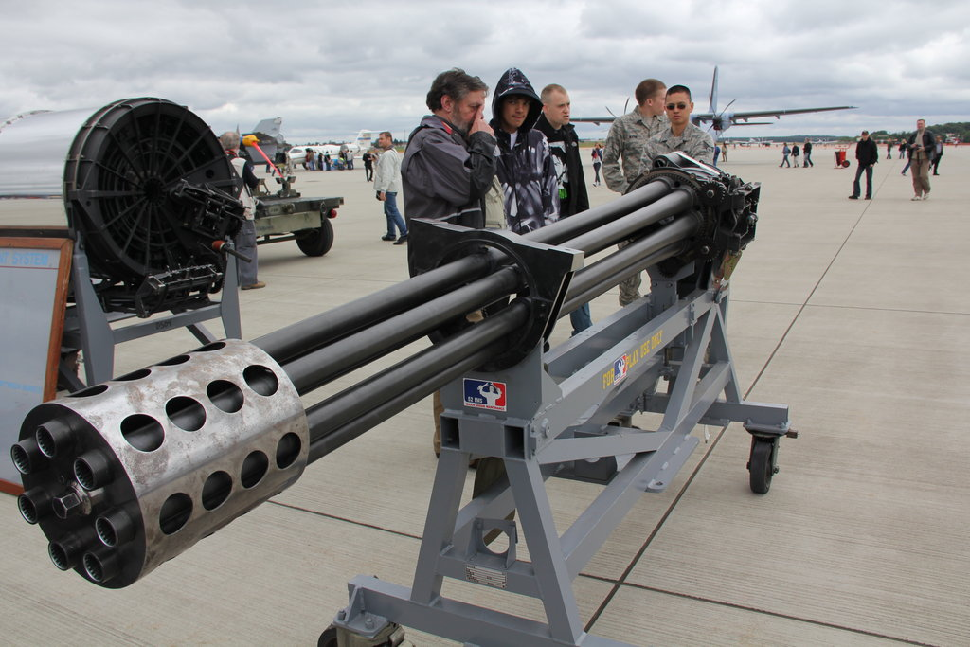
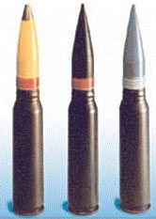
Notes:
http://en.wikipedia.org/wiki/GAU-8_Avenger
The General Electric GAU-8/A Avenger is a 30 mm hydraulically driven seven-barrelGatling-type cannon that is typically mounted to the United States Air Force's Fairchild Republic A-10 Thunderbolt II. Designed specifically for the anti-tank role, the Avenger delivers very powerful rounds at a high rate of fire. The GAU-8/A is also mounted to theGoalkeeper CIWS.

Slide 2
Math 152
Lesson | Topic | Reading
34 | GR #3
35 | Arc Length/Calc w/ Parametrics | 8.1 / 10.2
36 | Polar Coordinates | 10.3
Objectives:
Calculate curve length from parametric or Cartesian functions
Determine tangent lines to parametric curves

Slide 3
Refresher
What are we going to talk about?
Given a point (x0,y0) and slope (m): (y – y0)=m(x-x0)
Line: y(x) = f(x)
Slope (m): f’(x) = dy/dx
Concavity: f’’(x), concave up (+), concave down (-)

Slide 4
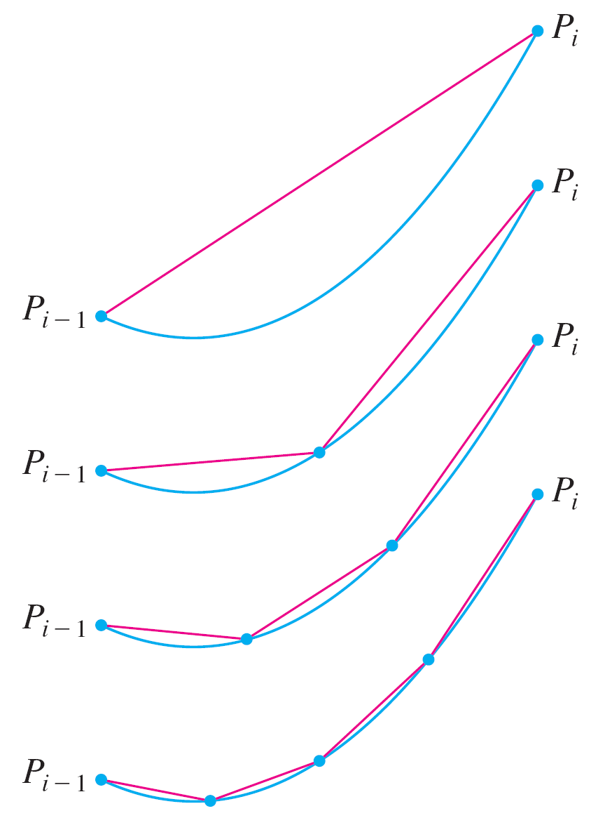
Arc Length
Given a curve C, divide the interval [a, b] into n subintervals of equal width Δx
More subintervals yields a better approximation
As n approaches infinity, this become integration

Slide 5

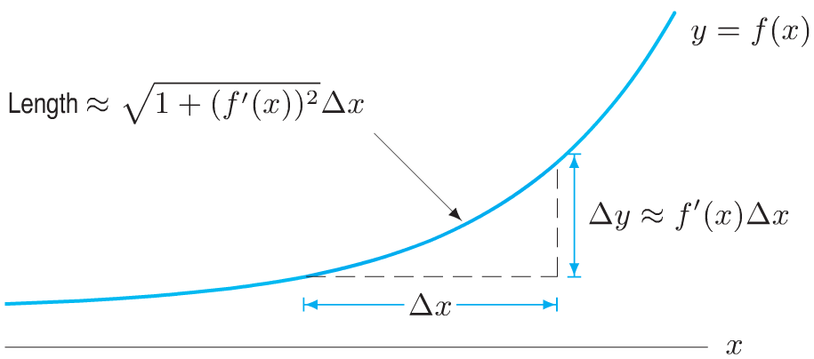
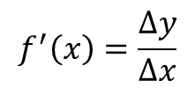



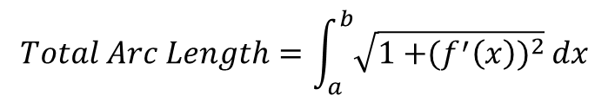

Arc Length
Notes:
What’s in the red box is important…the other is just FYI

Slide 6
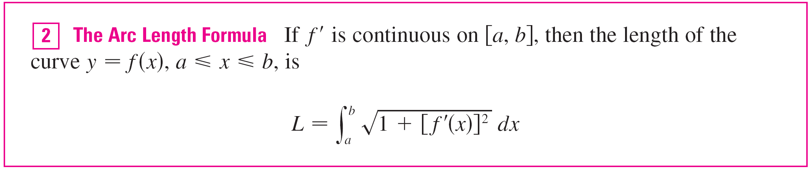
Arc Length
y(x) = f(x)
x(y) = g(y)

Slide 7
Example
Find the length of the arc of y² = x ³ between the points (1, 1) and (4, 8)

Slide 8
Example
For the top half of the curve we have
y(x) = x^{3/2}
So the arc length formula gives between (1, 1) and (4, 8)
y(x)² = x ³
= 7.633

Slide 9
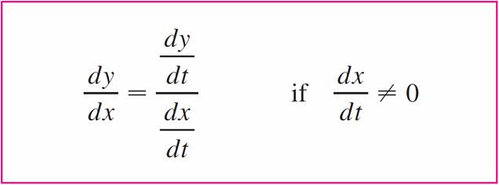

Tangents
If f and g are differentiable functions and we want to find the tangent line at a point on the curve
Then the Chain Rule gives
Equation 1 enables us to find the slope dy/dx of the tangent to a parametric curve

Slide 10

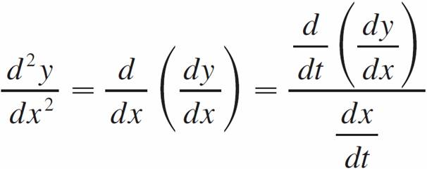
Tangents
We see from that the curve has:
a horizontal tangent when dy/dt = 0 (provided that dx/dt ≠ 0)
a vertical tangent when dx/dt = 0 (provided that dy/dt ≠ 0).
This information is useful for sketching parametric curves.
It is also useful to consider d ²y/dx² for concavity. This can be found by replacing y by dy/dx in Equation 1:

Slide 11
Example
A curve C is defined by: x = t² y = t ³ – 3t
(a) Show that C has two tangents at the point (3, 0) and find their equations.
(b) Find the points on C where the tangent is horizontal or vertical.
(c) Determine where the curve is concave upward or downward.
(d) Sketch the curve.

Slide 12

Example
(a) Solution:
What time does it get to (3,0)?
y = t ³ – 3t = t(t² – 3) = 0 when t = 0 or t =
This indicates that C crosses itself at (3, 0).
Substitute in time, slope
(y-0)=slope(x-3):

Slide 13
Example
(b) Solution:
C has a horizontal tangent when
dy/dx = 0, that is, when dy/dt = 0 and dx/dt ≠ 0.
dy/dt = 3t² – 3=0 --> t² = 1 or t = ±1.
Substitute back into: x = t² y = t ³ – 3t
(1, –2) and (1, 2).
C has a vertical tangent when
dx/dt = 2t = 0, that is, t = 0
(0, 0)

Slide 14
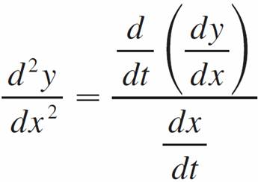
Example
(c) Solution
To determine concavity we calculate the second derivative:
Thus the curve is concave upward when t > 0 and concave downward when t < 0.

Slide 15
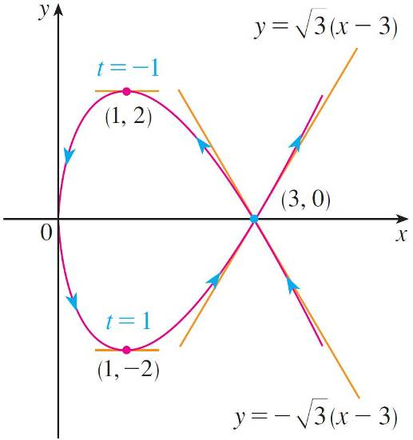
Example
(d) Solution

Slide 16
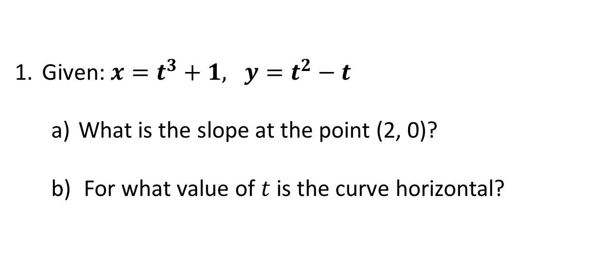
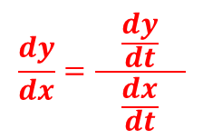

Desk Work
Notes:
𝟐=𝒕^𝟑+𝟏, 𝟎=𝒕^𝟐−𝒕
t = 1 t = 0, 1 … t = 1
𝐝𝒙/𝒅𝒕=〖𝟑𝒕〗^𝟐, 𝒅𝒚/𝒅𝒕=〖𝟐𝒕〗^ −𝟏, dy / dx = 〖(〖𝟐𝒕〗^ −𝟏)/𝟑𝒕〗^𝟐, @ t = 1, dy/dx = 1/3
dy / dx = 〖(〖𝟐𝒕〗^ −𝟏)/𝟑𝒕〗^𝟐 = 0, 2t-1 = 0, t = ½
(𝒅^𝟐 𝒚)/(𝒅𝒙^𝟐 ) = (d/dt(〖(〖𝟐𝒕〗^ −𝟏)/𝟑𝒕〗^𝟐)/(〖(𝟑𝒕〗^𝟐) = 2/9t^5
Integral from 1 to 2, y(t)x’(t) dt = 147/20 = 7.35 ….rough estimation (triangle) A = 7

Slide 17
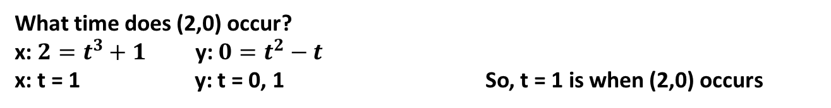
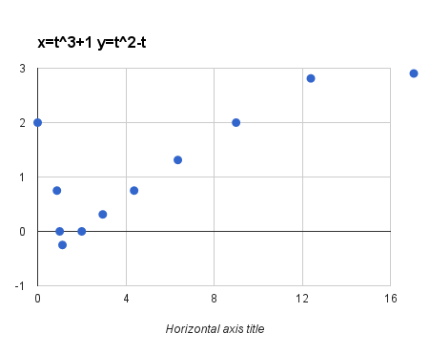
Solution
(2,0)

Slide 18
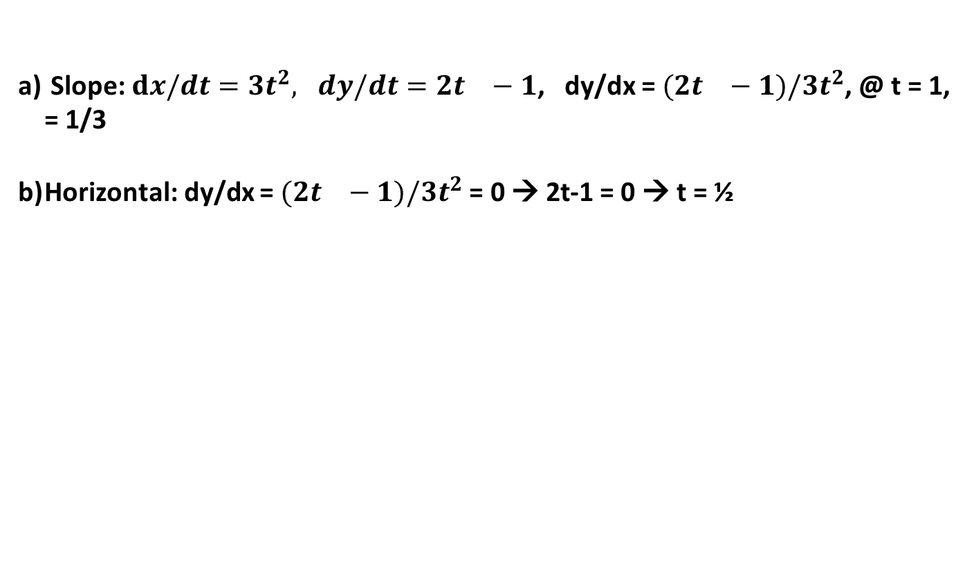
Solution

Slide 19
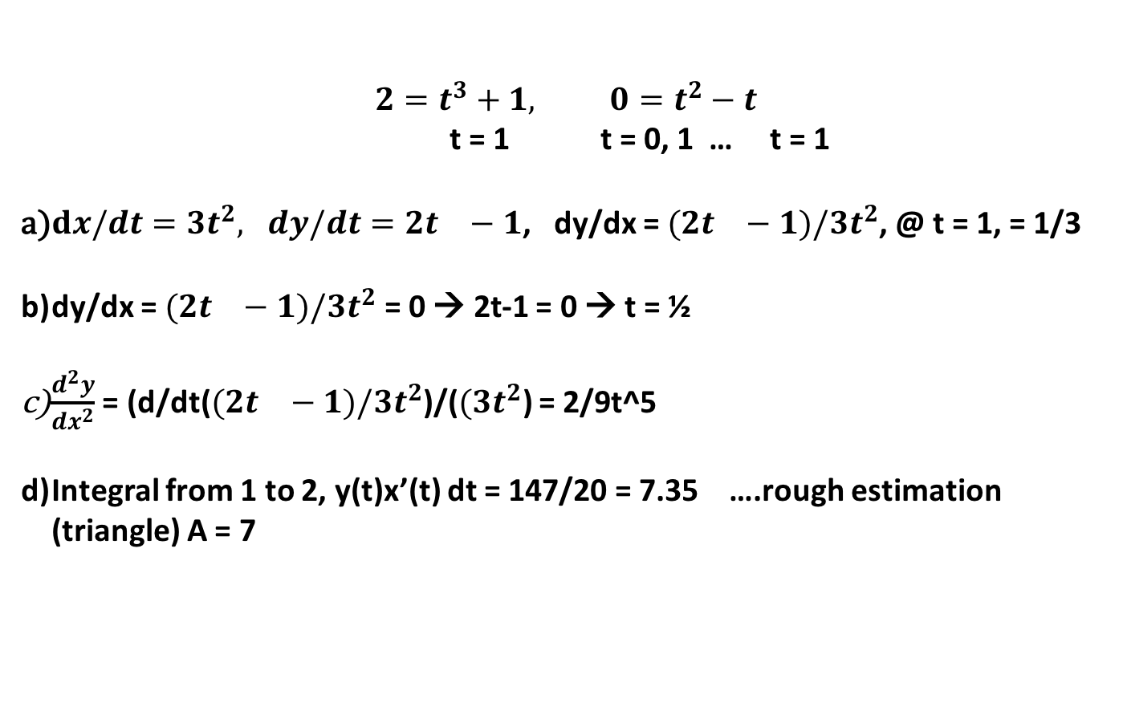
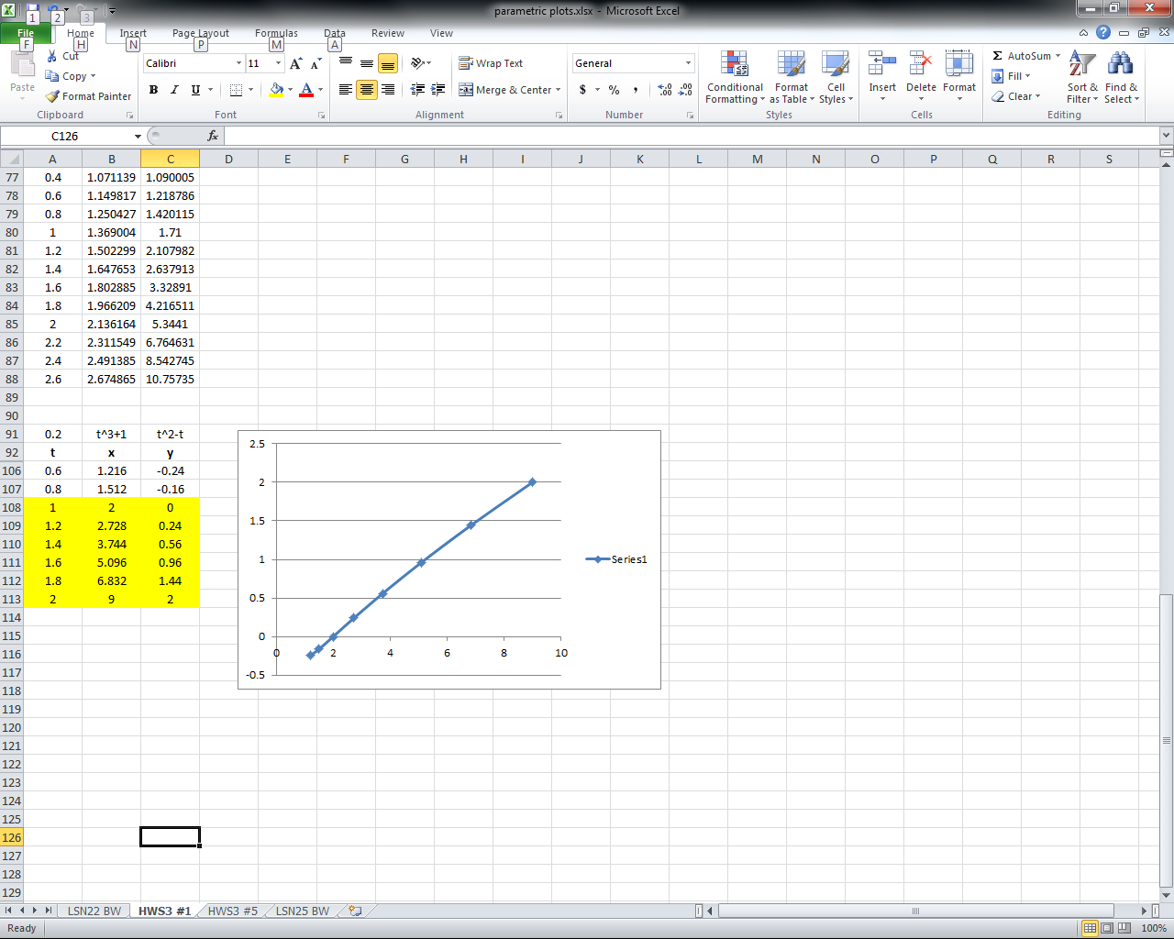
Solution

Slide 20
backups

Slide 21

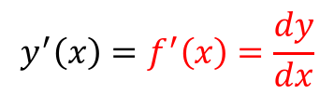
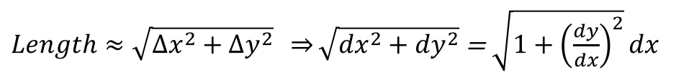
Arc Length
Notes:
What’s in the red box is important…the other is just FYI

Slide 22
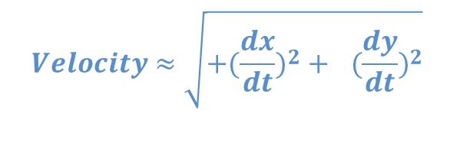


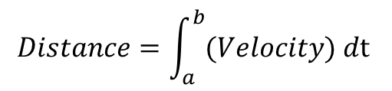
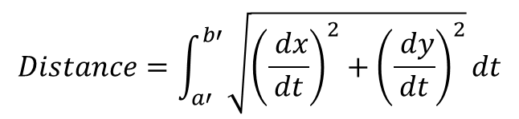
Arc Length
Notes:
Distance traveled = arc length

Slide 23
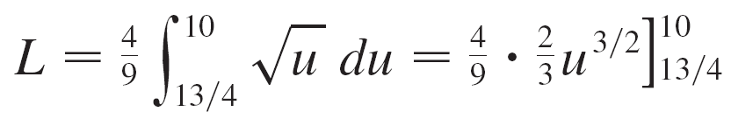
Example
Therefore

Slide 24
Arc Length
Notes:
What’s in the red box is important…the other is just FYI

Slide 25

GAU

Slide 26




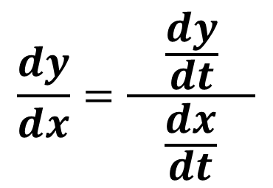
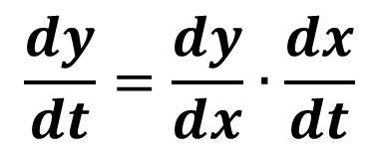
Tangents to Parametric Curves
Notes:
Chain rule

Slide 27




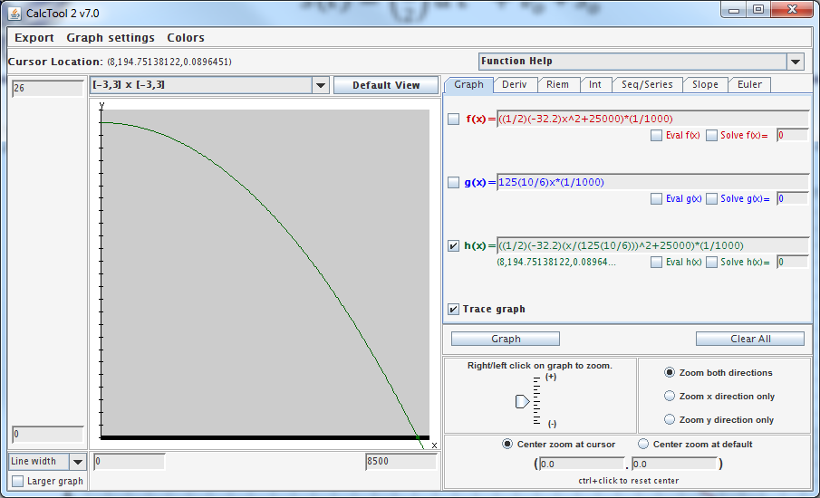
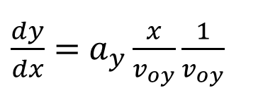
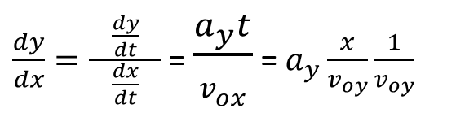
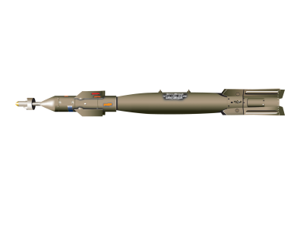

Ft (1000’s)
distance (ft)
Notes:
Ay = (-32.2 ft/s^2)
Vx = 125kts(10/6) (1nm/hr)(hrt/3600sec)(6000ft/nm) = (10/6)ft/s
The GBU-12 Paveway II laser-guided bomb is an American aerial bomb, based on the Mk 82 500-pound general-purpose bomb, but with the addition of a nose-mounted laser seeker and fins for guidance. A member of the Paveway series of weapons, Paveway II entered into service c. 1976. It is currently in service withU.S. Air Force, US Navy, US Marine Corps, Royal Canadian Air Force,Colombian Air Force, and various NATO air forces.
GBU-12 bombs (along with the balance of the Paveway series) are produced bydefense contractors Lockheed Martin and Raytheon. Raytheon began production after purchasing the product line from Texas Instruments. Lockheed Martin was awarded a contract to compete with Raytheon when there was a break in production caused by transferring manufacturing out of Texas. "Paveway II" refers specifically to the guidance kit, rather than to the weapon itself. See also GBU-16 Paveway II, where the same guidance unit is fitted to aMk 83 1,000-lb bomb.
The US Department of Defense has upgraded GBU-12 production versions to include GPSguidance modes. Lockheed Martin is the sole source for US Navy purchases of this version. Raytheon sells upgraded GBU-12s to the US Government and other nations. Raytheon production of the GBU-12 is centered in Arizona, Texas, and New Mexico. Lockheed Martin production is centered in Pennsylvania.
Laser-guided bombs are often labeled "smart bombs" because they are able to follow a non-ballistic trajectory when laser designation of the intended target is undertaken. According to Raytheon's fact sheet for the Paveway 2, 99 deliveries of guided munitions will yield a circular error probable (CEP) of only 3.6 feet, versus a CEP of 310 feet for 99 unguided bombsdropped under similar conditions.
Paveway II laser-guided bombs use what is known as "bang bang" guidance. This means the bomb's fins deflect fully, rather than proportionally when it is attempting to guide to the laser spot. For example, if it sees the laser spot and determines that it should make a change it deflects its fins until it has over-corrected and then it deflects back the opposite direction, creating a sinusoidal type of flight path. This type of guidance may be less efficient at times.

Slide 28
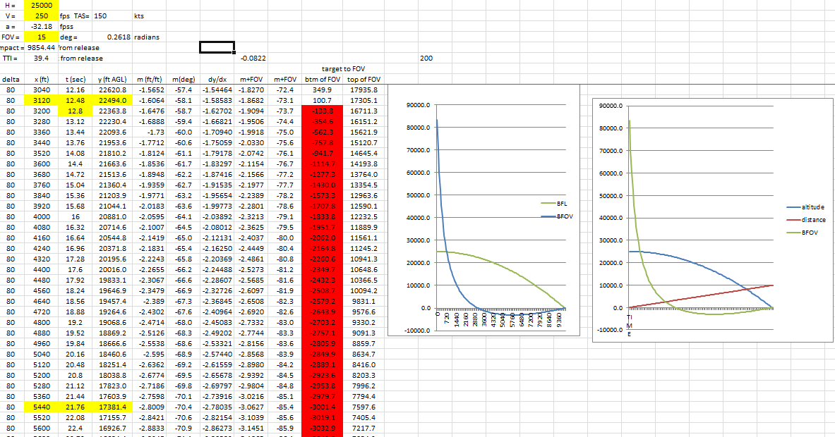

Slide 29

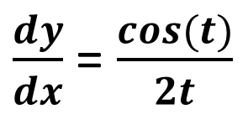
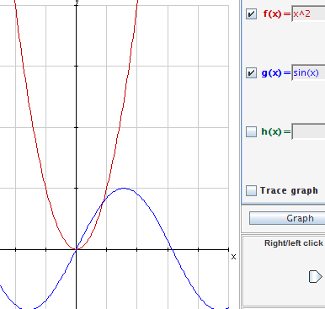
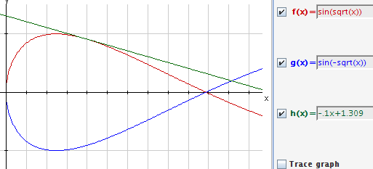
Find the slope at t = 2
@ t=2, (x,y) = (4, 0.91), m = -0.1)
t = -2
Notes:
Why not at the red circle? Because that occurs at t = -2
T = sqrt(x), y = sin(sqrt(x)) dy/dx = cos(sqrt(x))((1/2)x^(-1/2)) = cos(sqrt(x))/(2sqrt(x)) = cos(t)/2t

Slide 30
Arc Length
Notes:
What’s in the red box is important…the other is just FYI

Slide 31
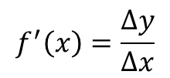

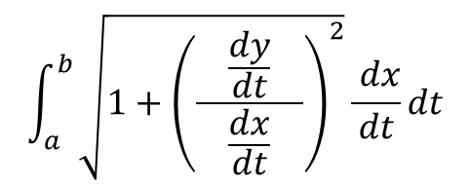
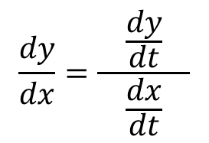
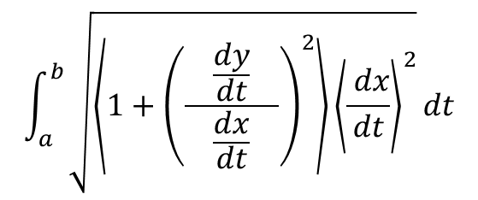
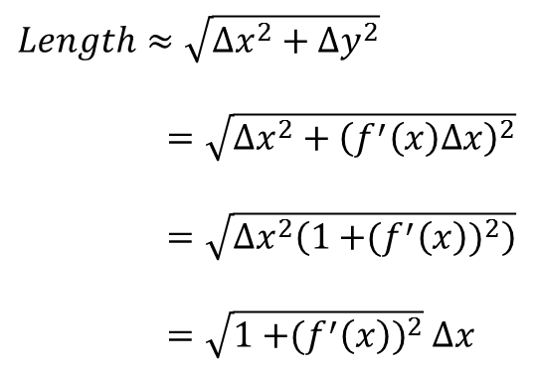
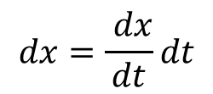
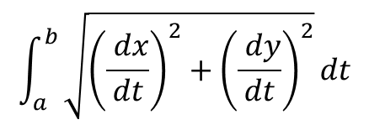
Parametric Arc Length

Slide 32
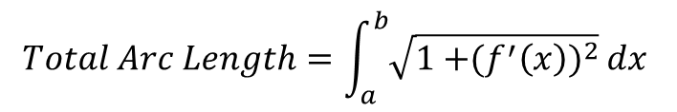
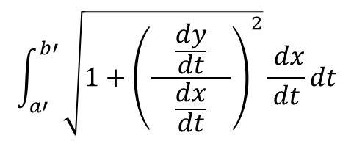
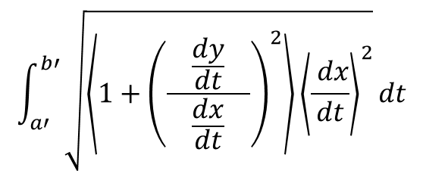
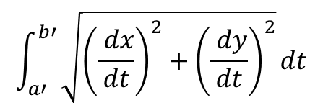
Parametric Arc Length
Notes:
Note: x = a @ t = a’,
or x = b @ t = b’

Slide 33
Arc Length
Notes:
Distance traveled = arc length

Slide 34

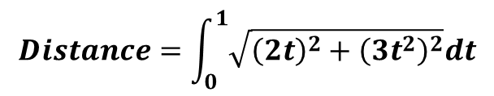
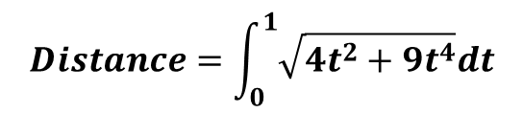
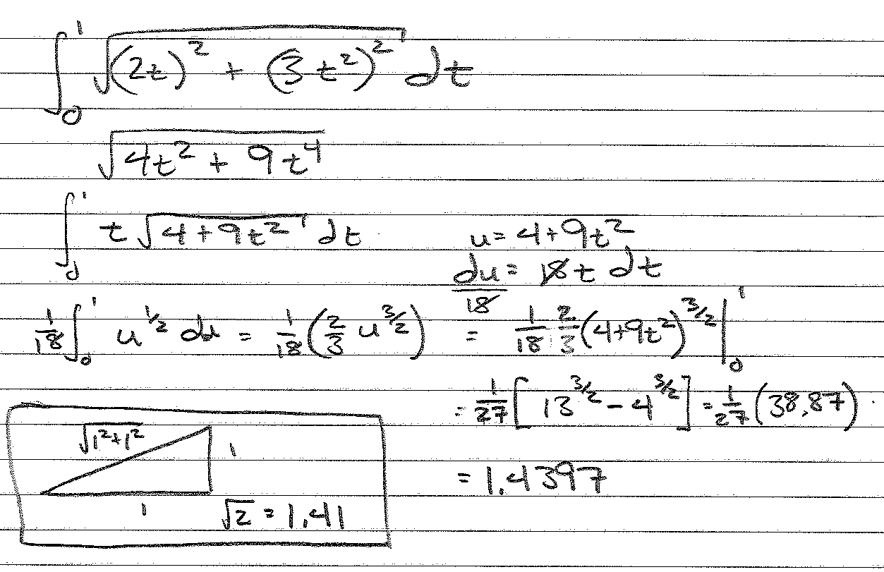


Find the distance from t = 0 to 1
t = -4
@ t=2, (x,y) = (4, 0.91), m = -0.1)
Notes:
Integrate “t(sqrt(4+9t^2)” from 0 to 1
Let u = 4+9t^2
du = 18t dt (du/18) = t dt
Integrate “(1/18)sqrt(u)du”
Approx 1.43
Note: Sqrt (1 + 1) = 1.41 (for a straight hypotenuse)
L =∫_𝑎^𝑏▒〖√(1〖+(𝑓^′ (𝑥))〗^2 ) 𝑑𝑥" " 〗, where y = x^(3/2), y’ = (3/2)x^(1/2)
Evaluated from x = 0^2 = 0 to x = 1^2 = 1
L = 1.4397

Slide 35





Area Under a Parametric Curve

Slide 36




t = 1/2, (x, y) = (1.1, -.3)
t = 1, (x, y) = (2, 0)
Notes:
((1+sqrt(1+4x))/2)^3+1
((1-sqrt(1+4x))/2)^3+1

Slide 37




Board Work
Find the arc length of the graph of the function over the specified interval.
Find the length of the parametric curve.
Notes:
Some of these are based on the use of integration tables—not doable without.
Will update.

Slide 38



Notes:
Estimate curve (pic 1, red line) from 0 to 2…from (0,0) to (2, 2.85) = 3.48
Note, value of integral (pic 2, blue line) at x = 2 is 3.55…slightly longer than the straight hypotenuse.

Slide 39



Notes:
Estimate original function (red line) from (3,9) to (6,35)…sqrt(3^2 + 26^2) = 26.17

Slide 40



Slide 41



